Slide 1
Datacenter Migration Journey Overview
Kirill Kotlyarenko
Hoster Datacenter Migration Program Lead
Microsoft Corporation

Slide 2
Datacenter Migration Journey
1
Sign Hoster DC Migration Program contract – DONE
2
Make a proposal for customers
3
Reach your customers
4
Identify workloads
5
Perform an assessment
6
Build and validate a migration plan
7
Move data

Slide 3
What are Customers looking to migrate to the Cloud?
Virtual Machines
Databases
Data
Applications
Azure

Slide 4
Two options to consider
Reserved VM Instances (RIs)
Discounts up to 72% for 1 year or 3 year commitment for specific VM size in a region
Can be exchanged or returned if needed (12% fee for returns, up to $50K per customer)
Highly recommended for workloads, running 24/7
Azure Hybrid Benefit (AHB)
AHB for Windows Server – Allows to leverage Windows Server licenses with active SA of the customer for Windows Server VMs
AHB for SQL Server – Allows to leverage SQL Server licenses with active SA of the customer for Azure SQL Database

Slide 5
Right customers for migration
1
Customers that pay you annually
2
Customers that want more elasticity
Customers with own licenses for Windows Server and SQL Server
3
4
Enterprise customers with specific compliance requirements
5
Customers that are interested in geo-expansion
6
Customers that want to use rich public cloud service portfolio and go beyond IaaS

Slide 6
Right Workloads
1
Workloads that can benefit from running not 24/7
2
Business-critical workloads, running 24/7
3
Windows-based workloads
4
SQL Server DBs
5
Heavy web apps
6
Stateless workloads, that can be containerized

Slide 7
Migration Plan v1
Build a list of participating customers
Build a list of workloads or assets that you wish to migrate
Write this down using migration plan template (link) and proceed to the assessment

Slide 8
Azure in CSP model

Slide 9
Cloud Solution Provider (CSP) – Innovative Business model for Microsoft Partners
Microsoft Azure
Sell Microsoft cloud services for business with your added value
Sell Integrated Offers and Services
Own and Control the Billing
Office 365
Dynamic 365
Provision Manage and Support
Own customer relationship
Enterprise Mobility Suite

Slide 10

Azure in CSP enables Partners to…
Set the price, the terms and directly bill customers
Directly provision, own and manage Azure subscriptions
Be the first point of contact for customer support
1
2
3
4
Create cloud subscription + partner offer
Set package price and sell to customers
Place order for Microsoft Cloud Services
Offer single packaged solution

Slide 11
One program, two different Business Models
CSP Direct model (1-Tier)
Partner works with Microsoft directly
Fixed discount for Azure
Partner needs to provide billing tools and build support practice
Credit check during the onboarding process
CSP Direct
CSP Indirect
Microsoft
Microsoft
CSP Indirect Provider
CSP Direct Partner
CSP Indirect model (2-Tier)
2 partner tiers:
CSP Indirect Provider (aka Distributor) – transacts to Microsoft, provides billing tools and technical support
CSP Indirect Reseller – sells Azure to customers through CSP Indirect Provider
CSP Indirect Reseller
Customer
Customer

Slide 12
Partner Center Portal
partnercenter.microsoft.com
Core of partner’s CSP business. Manage Azure customers in one place.
Partner Center Key Capabilities
Easy to Use web portal
Provision Customers & Subscriptions
Admin-on-behalf-of customers
Office 365, EMS, Dynamics 365, Azure
Multi-channel & Multi-partner capabilities
Automated invoicing
Rich set of APIs for integration
CSP Content & Resources

Slide 13
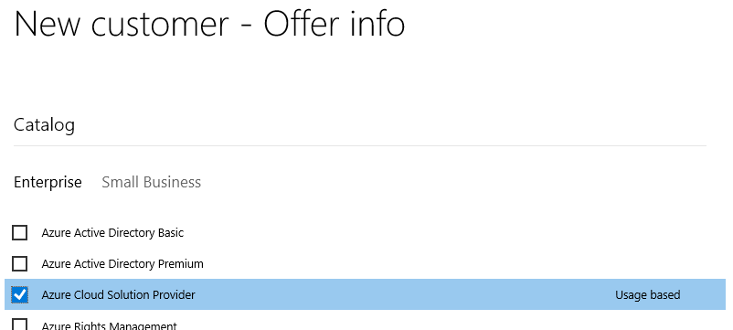
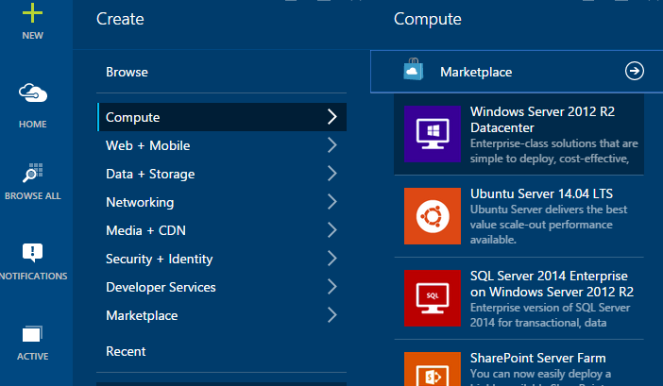
Selling Azure through CSP
Partner establishes customer relationship and “sells” Azure subscription
Services are created in the Azure Management portal
Usage occurs over the month
Microsoft bills the partner for the usage
Partner bills the customer for the usage
Microsoft Azure

Slide 14
Azure CSP Practices
What partners need to build to be successful in Azure CSP
1
2
3
4
Technical support practice
Billing practice
Deployment services practice
Cloud sales practice
CSP Direct partners get discount for Azure to implement it
CSP Indirect Reseller receives it from CSP Indirect Provider (Distributor)

Slide 15
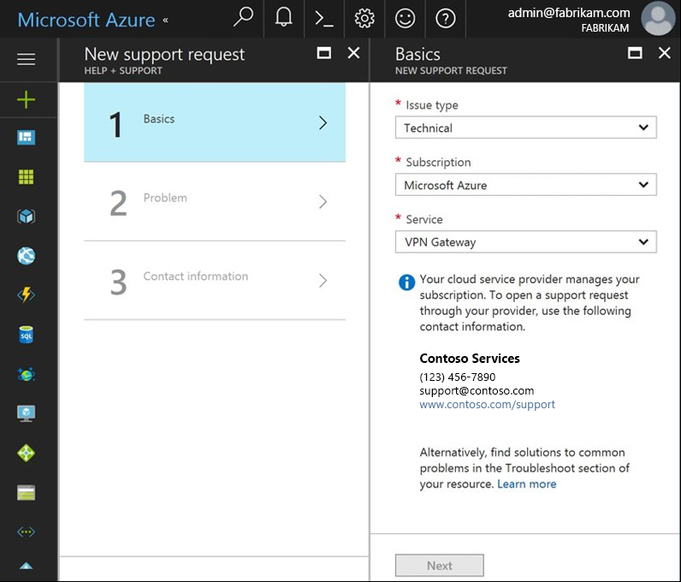
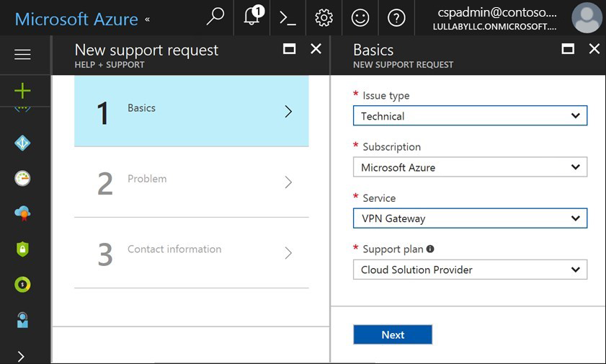
Microsoft doesn’t provide any support to CSP Customers
Customer view
CSP Partner view

Slide 16
Technical support for Azure services
1
2
3
4
Register a new customer request in the own tracking system
1st tier of support
Do basic troubleshooting
Check if there are any related service issues on Azure Resource Health
Provide solutions to the customer
2nd tier of support
If problem is not resolved – escalate the request internally and do deep troubleshooting
Ensure that the environment is fully supported by Microsoft
Provide solutions or fix the problem in on behalf the customer
Escalate issues to Microsoft
Only after steps 1-3 (details)
Microsoft provides different support options for CSP Partners
All escalation requests are still managed by the partner

Slide 17
Support options for CSP Partners
 | Included with CSP | Advanced Support for Partners (ASfP) | Premier Support for Partners (PSfP)
Submit Support Tickets On Behalf of End Customer | ✓ | ✓ | ✓
Support Account Management | No dedicated manager | Assigned from a regional pool | Designated support manager (TAM)
Technical break-fix | Through portal | Through portal + e-mail + phone | Through portal + e-mail + phone
Case Severity & Target Initial Response Times | Sev A: 2h Sev B: 4h Sev C: 8h | Sev A: 1h Sev B: 2h Sev C: 4h | Sev A: 1h Sev B: 2h Sev C: 4h
24x7 Critical Situation Support | -- | -- | ✓
Advisory “How To” Services | Requires MPN Silver/Gold competency | ✓ | ✓
Technical Presales Assistance | Requires MPN Silver/Gold competency | ✓ | ✓
CSP Integration Support | -- | Packaged | Customizable
Proactive Support Services | -- | Packaged | Customizable
 | Details | Details | Details

Slide 18
Pricing and billing of Azure services
Manage Azure pricing
Manage Azure billing
1
2
Set an end-customer price for Azure services
Provide guidance for pricing rules of different Azure services
Calculate the estimated monthly cost for customer workloads in Azure.
Define the billing rules between end-customer and CSP Partner
Provide consumption analysis capabilities to customers
Pay invoice from Microsoft (CSP Direct) or from Distributor (CSP Indirect) based on the consumption of all customers
Manage billing disputes and escalate billing issues to Partner Center support team

Slide 19
Possible integrations
Integration with Partner Center – Billing, customer provisioning
Partner Center REST API
Partner Center SDK
Integration on the Azure level – Service deployment, policies, customer identity management etc.
Azure Resource Manager APIs
Azure GRAPH APIs
More details: link

Slide 20
Azure IaaS

Slide 21
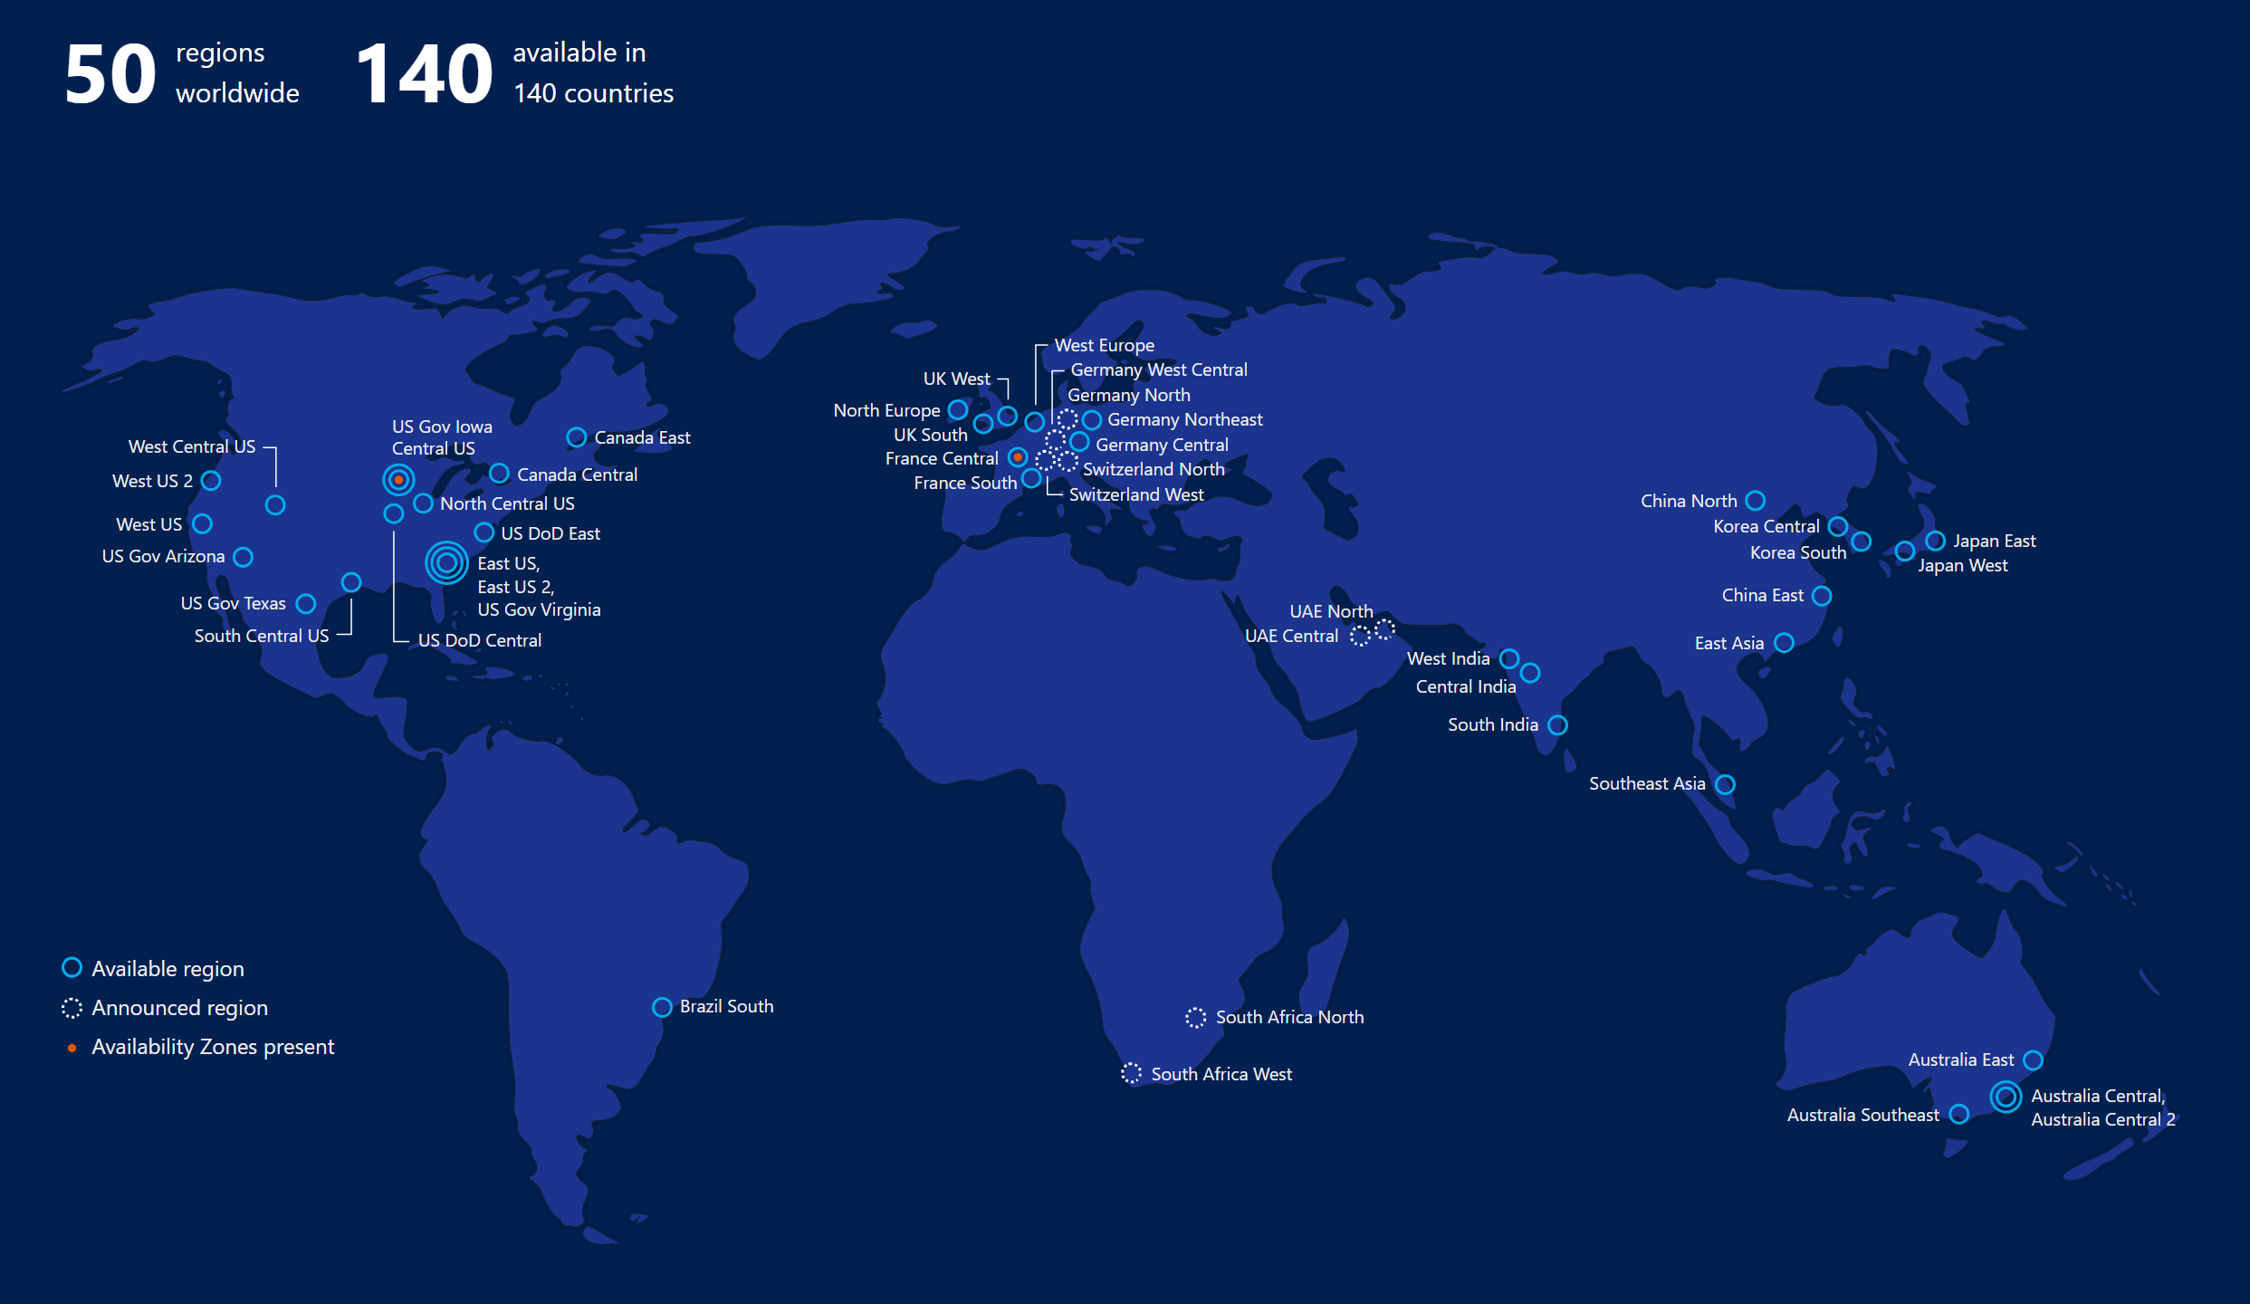

Slide 22
Core Components of Azure IaaS
Compute
Storage
Networking
Management
Virtual machines
Availability sets
VM Scale Sets
Etc.
Disks (Standard, premium)
Blob storage (Hot, cool)
Files
Etc.
Virtual networks
VPN, ExpressRoute
Load Balancer
DNS, Traffic Manager
Etc.
Azure Resource Manager (ARM)
Azure Active Directory
Portal
KeyVault etc.

Slide 23
Virtual Machines
Ubuntu, Red Hat, Windows, SUSE, CoreOS
Quick resize through reboot
Local temp storage (HDD or SSD)
Azure Storage for OS and data disks
Hundreds of items in marketplace

Slide 24
Compute Options for all Types of Apps
Entry level
Burstable
General Purpose
Compute Intensive
Storage Optimized
A
Av2
B
D
Dv2
Dv3
F
Fv2
L
Memory Optimized
Graphics Intensive
High Performance Computing
Purpose-built SAP HANA
G
Ev3
M
NC
NCv2
NV
ND
H
HANA
NCv3
NCv2
NCv2
(coming soon)
(coming soon)

Slide 25
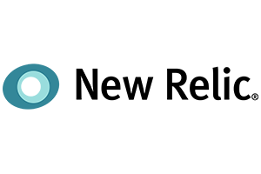

















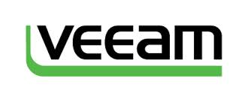








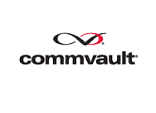




















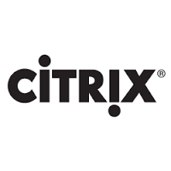





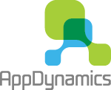






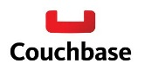







Leverage Azure Marketplace

Slide 26
VM Scale Sets
High performance provisioning of 1000+ VMs
Auto-configuration at scale
Auto-scale based on schedule and resource metrics
Easy updates at scale
Simple Portal Integration

Slide 27
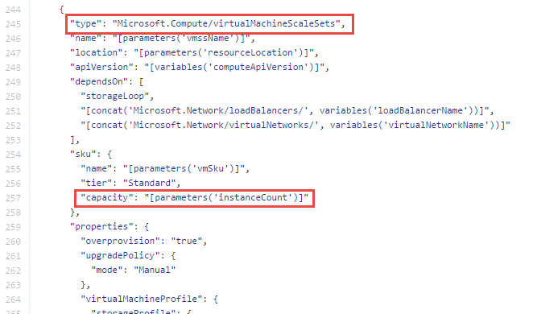
Why VM Scale Sets?
Manually scale with ‘capacity’ property
Autoscale with host metrics (MDM pipeline) or diagnostic extensions​
Small buy-in: Deploy/manage sets of 0 → 100 identically configured VMs ​
Guest OS patching: Patching primitives allow manually triggered rolling upgrades​​
High-availability – Implicit availability set with 5 FDs/5 UDs​
Availability Sets vs Scale Sets
Avail Set: Multiple different VMs (image, size, etc.); managed separately
Scale Set: Large count of the same VMs; managed together
Scale set: Reliable rapid provisioning and scale utilizing similarity of the VMs

Slide 28
Azure Batch
Compute pools for job processing
Automatic scaling and regional coverage
Linux and Windows
Automatically recover failed tasks
Input/Output handling
Low-Pri (discounted) option

Slide 29

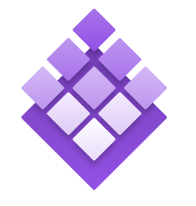

Azure Container Service
Standard Docker tooling and API support
Streamlined provisioning of DCOS and Docker Swarm
Linux and Windows Server containers
Azure and Azure Stack
Azure Container Service
Kubernetes
DC/OS
Swarm

Slide 30
Azure Container Instances
Simplest and easiest way to run individual containers in the cloud
No VM management
Per-second billing with customized resource requests
Linux and Windows Server containers

Slide 31
Azure App Service
Enterprise-grade apps
Fully managed platform
High productivity development
Global data center footprint
Hybrid support
Built-in auto scale and load balancing
High availability with auto-patching
.NET, Java, PHP, Node, and Python
Staging and deployment
AAD integrated
Secure + compliant
Reduced operations costs
Backup and recovery
Source code control integration
App gallery marketplace

Slide 32

Microsoft Global Network
Greenland
Svalbard
United States
Sweden
Norway
Russia
Canada
United Kingdom
Poland
France
Ukraine
Kazakistan
Russia
One of the largest private
networks in the world
8,000+ ISP sessions
130+ edge sites
44 ExpressRoute locations
33,000 miles of lit fiber
SDN Managed (SWAN, OLS)
United States
Turkey
Algeria
Iran
China
Pacific Ocean
Mexico
Atlanta Ocean
Libya
Egypt
Saudi Arabia
India
Myanmar (Burma)
Mali
Niger
Chad
Sudan
Pacific Ocean
Nigeria
Ethiopia
Venezuela
Colombia
Dr Congo
Indonesia
Peru
Brazil
Angola
Zambia
Indian Ocean
Bolivia
Nambia
South Africa
Australia
Argentina
Owned Capacity
Data center
Leased Capacity
Moving to Owned
Edge Site
DCs and Network sites not exhaustive

Slide 33
Robust Networking Infrastructure Services
Virtual Network
Provision private networks, optionally connect to on premise datacenters. NSG, User Defined Routes, & IP addresses
Azure DNS
Host your DNS domain in Azure
Load Balancer
Deliver high availability and network performance to your applications
Content Delivery Network
Ensure secure, reliable content delivery with broad global reach
Application Gateway/WAF
Build scalable and highly-available web front ends in Azure
Traffic Manager
Route incoming traffic for high performance and availability
DDoS Protection
Protect your Azure resources from DDoS attacks
ExpressRoute
Dedicated private network fiber connections to Azure
VPN Gateway
Establish secure, cross-premise connectivity
Network Watcher
Network performance monitoring and diagnostics solution

Slide 34
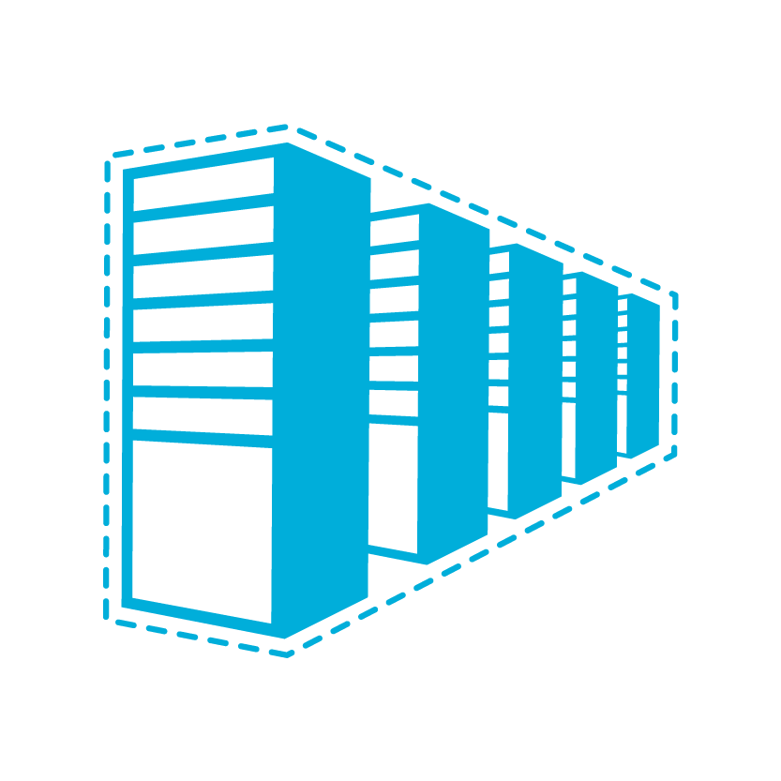


Connectivity to Azure
CLOUD
CUSTOMER
CHARACTERISTICS
Internet facing with public IP addresses in Azure
DNS, load balancing, DDoS protection, WAF
Internet Connectivity
Remote Access to VNet/On-prem
Connect from anywhere
Mac, Linux, Windows
Radius/AD authentication
Remote access point-to-site connectivity
High throughput, secure cross-premises connectivity
BGP, active-active for high availability & transit routing
Site-to-site
VPN connectivity
ExpressRoute private connectivity
Private connectivity to Microsoft services (O365, Azure PaaS services)
Mission critical workloads

Slide 35
Connectivity within Azure
CLOUD
CLOUD
CHARACTERISTICS
Same-/cross-region direct, private VM-to-VM connectivity
NSG & UDR across VNets
GatewayTransit for hub-and-spoke
VNet Peering
Transitive routing via BGP and VPN gateways
Secure connectivity via IPsec/IKE across Azure WAN links
VNet-to-VNet via Gateways

Slide 36
Azure Storage Services
IaaS
PaaS
Storage
Virtual machines
Networking
Existing frameworks
Web and mobile
Microservices
Serverless Compute
DISKS
Persistent disks for Azure IaaS VMs
Premium Storage Disks option: SSD based, high IOPS, low latency
FILES
Fully Managed File Shares in the Cloud
SMB and REST access
“Lift and shift” legacy apps
BLOBS
Highly scalable, REST based cloud object store
Block Blobs: Sequential file I/O
Cool Tier Available
Page Blobs: Random-write pattern data
Append Blobs
TABLES
Massive auto-scaling NoSQL store
Dynamic scaling based on load
Scale to PBs of table data
Fast key/value lookups
QUEUES
Reliable queues at scale for cloud services
Decouple and scale components
Message visibility timeout and update message to protect against unreliable dequeuers
Built on a unified Distributed Storage System
Durability, Encryption at Rest, Strongly Consistent Replication, Fault Tolerance, Auto Load-Balancing

Slide 37

What are Managed Disks?
Simple – Abstracts storage accounts from customers
Managed by Azure
Granular access control – Top level ARM resource, apply Azure RBAC
PAGE BLOBS
Better performance – Storage account limits do not apply
OS disk
Data disk
Big scale – Up to 10,000 disks per region per subscription
Managed Storage accounts

Slide 38
Managed Disks – Best Practices
Use SSD Disks for Production workloads
Only Managed Disks for new workloads
Upgrade legacy unmanaged to managed when possible
RAID for redundancy is not necessary
RAID/StorageSpaces for performance as needed
Durability doesn’t remove the need for backups
Performance
Local SSD is definitely temporary, use if you can tolerate loss
Enable read caching where appropriate for better performance
Understand VM limits vs Disk limits vs Network throughput limits

Slide 39
Azure Database Services

Slide 40


Why Azure SQL Managed Instance?
Are your customers interested in moving to cloud?
Want to close your data center
Current hosting solution is high maintenance
You’re asked to do more with less
Want to expand your reach globally
Managed Instance brings PaaS closer to you!
???
Do your customer want to avoid app rewrites but still benefit from PaaS?

Slide 41
What is SQL Database Managed Instance? DBaaS designed to for all SQL Server applications
SQL Database (PaaS)
Singleton
Elastic Pool
Managed Instance
Unmatched app compatibility
Unmatched PaaS capabilities
Favorable business model
Fully-fledged SQL instance with nearly 100% compat with on-prem
Lowest TCO + rich Azure ecosystem
Built-in automatic management
Compliance certifications
Competitive
Transparent
Core and Storage
Frictionless

Slide 42
Managed Instance: Unmatched PaaS Capabilities
On-demand resources & elasticity
No need to provision for that monthly/yearly peak
Built-in high availability
99.99% SLA with automatic failover
Business continuity
Automatic backups, point-in-time restore, long term retention
Backups kept in geo-redundant storage
Active geo-replication (<5 sec RPO)
Automatic patching/version updates
The service guarantees availability and no regression in experience
Built-in intelligence
Threat Detection
Automatic performance tuning & Intelligent Insights

Slide 43
How to Choose Between PaaS and IaaS?
If you
Need control over/access to the operating system
Have to run your app or agents side-by-side with the database
Want to continue to manage all aspects of your solution
…then IaaS (SQL Server on Azure VM) is the right solution for you.
Otherwise
…we recommend PaaS (Azure SQL Database or Managed Instance)
Much better total cost of ownership
You can focus on your business, and innovate

Slide 44
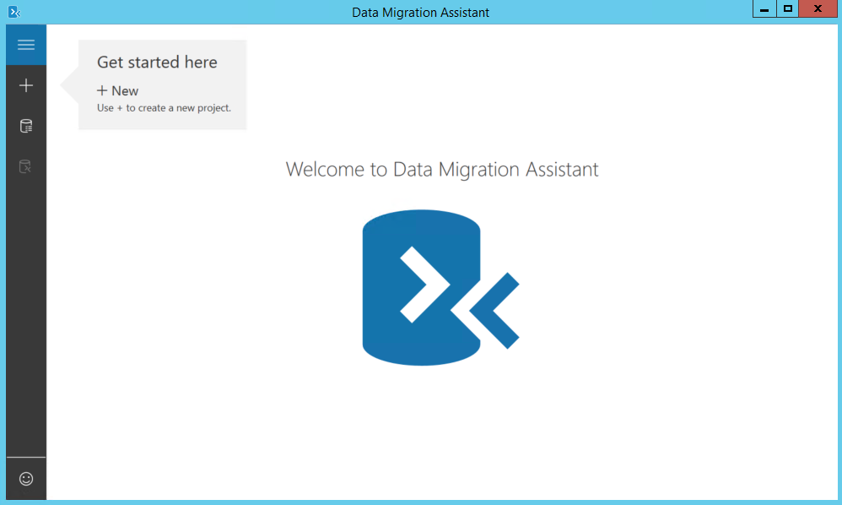
Some Apps don’t need Managed Instance
You can migrate some apps w/o any changes, today
Starting migration now by
Downloading and running Data Migration Assistant
Automated assessment will identify databases that are safe to move, w/o changes

Slide 45
Managed Instance: Destination for Even the Most Demanding Applications
Offers full security & isolation
VNET enables full isolation, without public IP addresses
VPN can make it part of your enterprise network
Decreases cost and risk of migration
Instance design increases compatibility with on-premise SQL Server
Database Migration Service further simplifies and automates migration
Offers new business model and pricing
Ability to use on-premise SQL licenses

Slide 46


Nearly 100% Compatibility with SQL Server
Quick migration
Native backup, restore
Programmability & extensibility
Cross-database queries & transactions, global temp cables, CLR, R Services
Security
TDE, SQL Audit, Always On, Dynamic Data Masking
Scheduler/notifications
SQL Agent, DBMail, Alerts
Scenario enablers
Change Data Capture, Service Broker, Transactional Replication, Log Shipping
Troubleshooting
DMVs/Xevents, Query Store
Support is coming in stages until General Availability of Managed Instance

Slide 47
Migration: Version compatibility
Most users would prefer the latest version
10% doesn’t care
The major concern is risk associated to upgrades
9% must run the same version
We will support migrations from SQL 2005+
81% would prefer the latest version
We will keep supporting old version DB compat levels in cloud

Slide 48
Reliable and seamless migrations Azure Database Migration Service (DMS)
Fully managed database migration service for both operational databases and data warehouses
Supports minimal down time migrations
SQL DB
Supports both homogeneous and heterogeneous source-target pairs
Initial focus on reliability and performance
Iterative addition of source-target pairs
Oracle
SQL
SQL
Continued investment in friction-free competitive conversions
Note: For more information, contact datamigrationteam@microsoft.com.

Slide 49
Migration: SSIS/SSAS/SSRS
These services will not be installed side-by-side with Managed Instance
Recommendation: Move to PaaS model
Migrate your SSIS packages to new SSIS PaaS service
Migrate your OLAP models to Azure Analysis Services
or run these services in Azure virtual machines
For SSRS, the recommendation is to run in a virtual machine

Slide 50
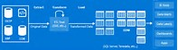
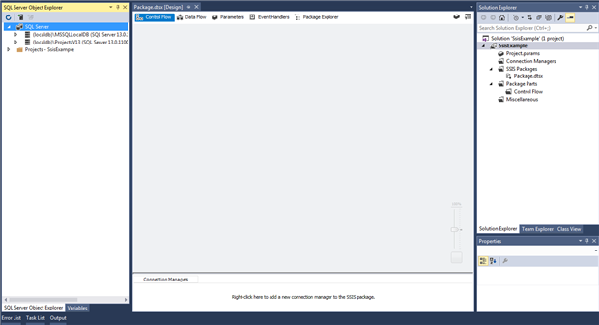
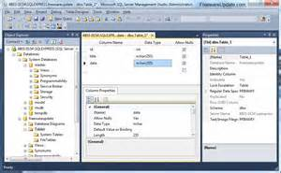
SSIS PaaS Service (In Preview)
Goal: Execute your SSIS packages, without changes
How?
SSIS instance provisioned under Azure Data Factory
Catalog (SSISDB) can be stored on Managed Instance
Authoring/deployment by SSDT
Execution/management by SSMS and SQL Agent
Provisioned on-demand, tunable scale
ADF (ENTRY POINT, ORCHESTRATION, DESIGN)
Provision
Execute/ Manage
SSIS PaaS on ADF compute resource
Author/
Deploy
Cloud
Author/Deploy
On-Premises
Execute/Manage
SSDT (ENTRY POINT)
SSMS (ENTRY POINT)
Author/Deploy
SSIS Server
Execute/Manage

Slide 51
Azure is the most economical destination for SQL Workloads*
Save up to 55% with Azure Hybrid Benefit for SQL Server (Managed Instance pricing)
Total monthly cost of 8 vCore Managed Instance Business Critical option
Up to 55% savings¹
What is Hybrid Benefit for SQL Server?
An Azure benefit that allows you to use your on-premises SQL Server licenses to save on SQL Database Managed Instance. You can save up to 30% on Managed Instance
How do you qualify?
You must have on-premises SQL Server licenses with active Software Assurance
How do you activate this benefit?
Deploy a SQL DB Managed Instance and select Azure Hybrid Benefit as an option in the portal.
Learn more
Customer total cost
License included
With Azure Hybrid Benefit
 | General Purpose (GA) |  | Business Critical (GA)
Pricing (monthly) | License Included | AHB for SQL Server | License Included | AHB for SQL Server
8 vCores | $1,501 | $906 | $4,044 | $1,812
16 vCores | $3,002 | $1,812 | $8,087 | $3,623
24 vCores | $4,503 | $2,717 | $12,130 | $5,435
Type of Storage/IO | Included with Compute (per SKU) | Additional price
General Purpose | 32 GB | $0.125/GB-Month
Business critical | 32 GB | $0.250/GB-Month
IO rate | NA | $0.20 per 1 million requests
¹ Savings based on eight vCore Managed Instance Business Critical in East US Region, running 730 hours per month. Savings are calculated from full price (license included) against base rate (applying Azure Hybrid Benefit for SQL Server), which excludes Software Assurance cost for SQL Server Enterprise edition, which may vary based on EA agreement. Actual savings may vary based on region, instance size and performance tier. Prices as of December 2017, subject to change.
*Based upon comparison of on-demand pricing on Azure for Managed Instance versus running SQL on AWS RDS.

Slide 52
Applying Azure hybrid benefit for SQL Server
How to calculate instances eligible for the hybrid benefit
Example:
Customer A has:
10 Standard Edition license cores
10 Enterprise Edition license cores
Wants a:
8 vCores Managed Instance
Calculation = (10 Standard license cores * 1 core) + (10 Enterprise license cores * 4 cores) = 50 cores
Eligible number of instances:
(50 cores / 8 vCore instance) = 6 eligible instances
Example:
Customer B has:
5 Standard Edition license cores
20 Enterprise Edition license cores
Wants a:
16 vCores Managed Instance
Calculation = (5 Standard license cores * 1 core) + (20 Enterprise license cores * 4 cores) = 85 cores
Eligible number of instances:
(85 cores / 16 vCore instance) = 5 eligible instances
Managed Instance is available in 8, 16, 24, 32 and 40 vCore instances
The number of instances eligible for Azure Hybrid Benefit is calculated based upon
number and type of licenses you are exchanging
Managed Instance vCore selection, rounding down to the nearest whole value.
1 Standard license core = 1 General Purpose core
1 Enterprise license core = 4 General Purpose cores (virtualization benefit)

Slide 53
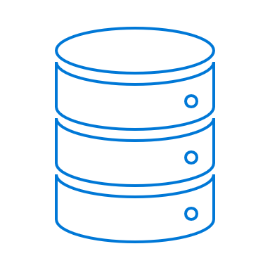

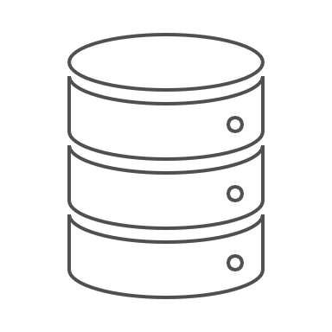
High-Virtualization benefit for AHB for SQL Server
For virtualized EE workloads, customers get 4X vCore on Azure SQL DB vs. 1X core on Azure IaaS
SQL Database Managed Instance
Cost on SQL DB (MI)= $6.21
@1:4 Trade-in
AHB for SQL Server with Managed Instance
8 vCore at Base rate w/ SA
8 vCore at Base rate w/ SA
8 vCore at Base rate w/ SA
8 vCore at Base rate w/ SA
$1.55
$1.55
$1.55
$1.55
Enterprise Edition Customer
Highly Virtualized
e.g. 32 core virtualized workload with 8 core SQL EE License
SQL DB will be ~22% cheaper than Azure IaaS
Cost on Azure IaaS= $7.92
Hosted/VM
@1:1 Trade-in
License Mobility for Azure IaaS Standard SE
8 core at BYOL w/ SA
8 core at License Included
8 core at License Included
8 core at License Included
$2.39
$1.85
$1.85
$1.85
Customer must purchase License Included Cores to get equivalent value on Azure IaaS
*All the SKUs above are 8 vCPU or vCore memory optimized equivalent. (D13v2 for Azure IaaS). The SA cost are based Open NL EE for SA. The License included prices are 8 core D13v2 for Azure IaaS. US East price. ** Prices as on Oct 2 2017

Slide 54

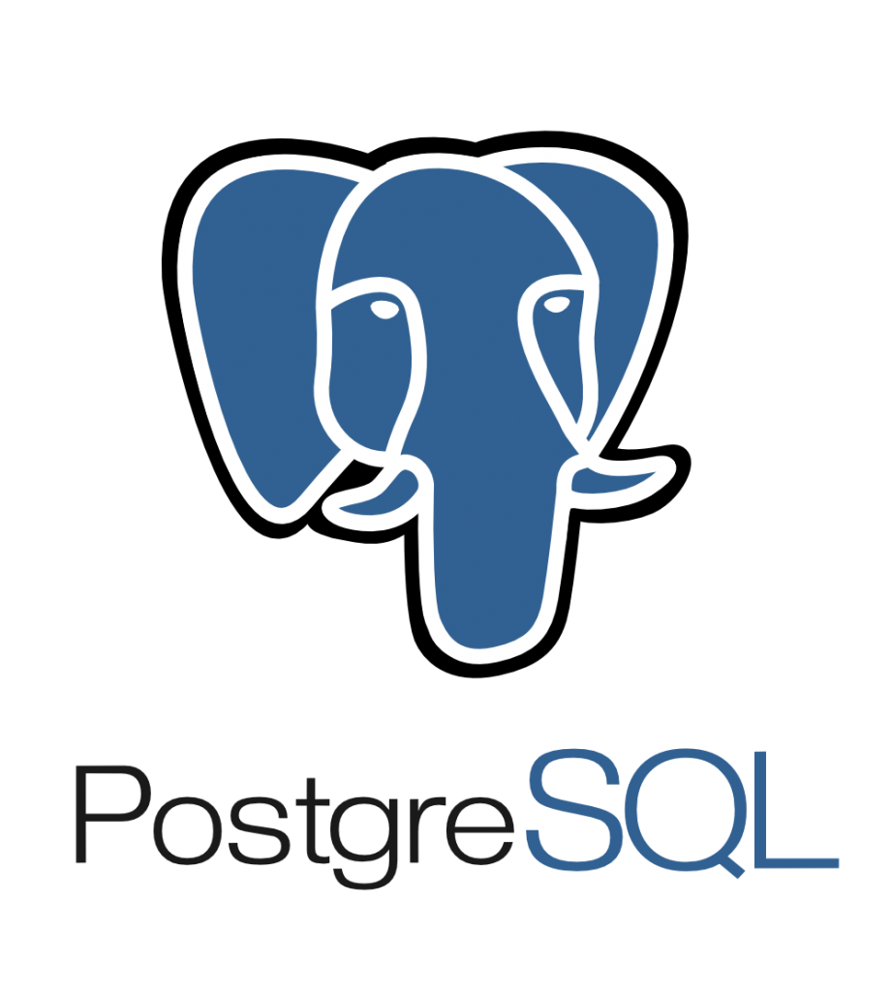
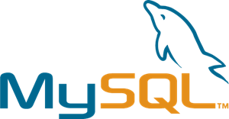
Azure Database for MySQL/PostgreSQL/MariaDB Managed community version of MySQL, PostgreSQL, and MariaDB
Focus on your apps by leaving the management and patching of your infrastructure and database to an enterprise-ready cloud service
Automatic updates
Automatic security fixes
Automatic new feature updates
My

Slide 55
Migration Technics

Slide 56
Migration Approaches
Re-deploy
Backup the workload configuration, deploy new VM in Azure and restore the configuration
Backup and restore the database
Good for stateless workloads, clean installation using Azure Marketplace image
Consider containers as an option instead of VMs
Workload-level Scale-out
Configure on-prem to Azure connectivity using S2S VPN or Express Route
Deploy additional domain controllers in Azure
Deploy additional nodes of the workload in Azure (e.g. heavy web apps and worker nodes)
VM Lift & Shift
Azure Site Recovery (ASR) as a recommended and free solution for migration to Azure at scale
Deploy ASR agents on VMs, replicate to Azure, failover.
Database-level migration
Using technologies like SQL Server AlwaysOn Availability Groups
Azure Database Migration Service (DMS) for migrations to Azure SQL Database
Attunity Replication for Microsoft – free solution, extending the capabilities of DMS
Large data migrations
Azure File Sync or StorSimple Virtual Appliance to upload large amounts of data to Azure
Disk import and Azure Databox

Slide 57

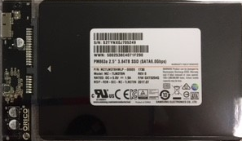
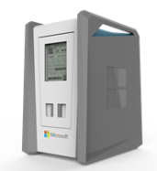

Uploading large amounts of data to Azure
Disk Import
Disk Rental
Data Box
StorSimple Virtual Appliance
Capacity: <10TB
Customer supplied disk
USB/SATA Interface
Ships in tamper resistant case
High capacity with Super Transport
Capacity: <10TB
Azure leased service
Tamper resistant
Low complexity - USB
Low cost
Capacity: 100TB
Human scale: < 50 lbs.
Ruggedized, tamper, water resistant
SMB Interface
Large Fleet Size
Automated Ordering and Managed Service in Azure
Capacity: <64TB
Deploy on Hyper-V or vShere host on-prem
Replicate data to Azure
Extract replicated data
Specifications
Currently Available
Preview Mid-year ‘18
Currently in Preview
Currently Available
Availability

Slide 58
Migration Assessment
Purpose of migration assessment – build a detailed migration plan and present it to customers
Steps
Deploy Cloudamize in the source environment on all servers with migration potential
Leave it for 2 weeks to collect data
Cloudamize detects OSs and SQL Server editions, analyzes usage trends to recommend RIs and checks if ASR can be used for lift&shift migration
Use DMA to assess detected SQL Server workloads
Detect non-SQL Server databases and select a migration approach manually
Build reports and prepare offers for each customer

Slide 59
VM assessment with Cloudamize
SaaS solution for cloud migration discovery & assessment
Supports VMWare 5.0+, Hyper-V 2008 R2+ and non-virtualized servers
VMs running on exotic hypervisors can be treated as non-virtualized servers
Hypervisor lever assessment for Vmware – no need to touch tenant VMs
Agent-based or agent-less deployment options.
Needs 14 days to collect data and build reports
To get Cloudamize licenses for free – Send a request to dcmsupport@microsoft.com That’s $40/VM value, available to DCM partners free of charge

Slide 60
Database Assessment With DMA
Microsoft Database Migration Assistant (DMA) is a free tool to analyze SQL Server DB compatibility with SQL Server 2017 and Azure SQL Database
Can analyze if database can be moved to Azure SQB Database (PaaS or Managed Instance)

Slide 61
Building V2 of the Migration Plan
For each customer
1
Calculate the cloud cost and compare it with current cost
2
Choose how to migrate VMs and databases
3
Present offer to customer

Slide 62
Execute the Migration Plan
1
Create Customer accounts in Partner Center
2
Create Azure subscriptions, vNets and establish site-to-site connectivity
Deploy ASR
3
4
Deploy DMS
5
Migrate workload by workload
6
Implement Azure Advisor recommendations to optimize workloads for Azure

Slide 63
Best Practices
Cost is not the only deciding factor for customers. SLA, certifications, development strategy, rich service portfolio can be more important for long-term considerations
Try to unveil hidden opportunities during the assessment. Include more VMs to the discovery scope using free Cloudamize licenses benefit
Every customer runs databases. That’s a huge revenue opportunity for CSP partners, especially for SQL Server. Don’t miss it
Migration with downtime is a good option if possible. Re-deploy usually requires less efforts and fresh environment is usually more stable (don’t bear existing configuration issues and garbage from on-prem)
Uptime of the workload is different from VM uptime. Customers may not even notice that VM was disabled during the migration if workload remains accessible
Azure Traffic Manager can help with IP address changes during the migration.

Slide 64
Next Steps
Review aka.ms/dcmkit
Reach us at dcmsupport@microsoft.com

